Slide 1
Capstone project week 17
Linear optimization project

Slide 2
Problem Statement
Problem scenario : With the machinery you have right now, you see that you can create 200 Type X ventilators per hour and 140 Type Y ventilators per hour. After some calculations, you note that the profit per Type X ventilator is $25 and the profit per Type Y ventilator is $30. You have also discovered that in a week you can create a maximum of 6000 Type X ventilators and 4000 Type Y ventilators because of the person-hours and capacity of specialists available to you.
Note that you have only 40 hours per week to produce them.
Profit or objective function=25X+30Y
Limitations
Time constraint :maximum time available for both ventilators' creation
Production constraint :Time/hour creation of ventilators
What is the right amount of 𝒙𝟏, 𝒂𝒏𝒅 𝒙𝟐? Where X and Y are decision variables

Slide 3
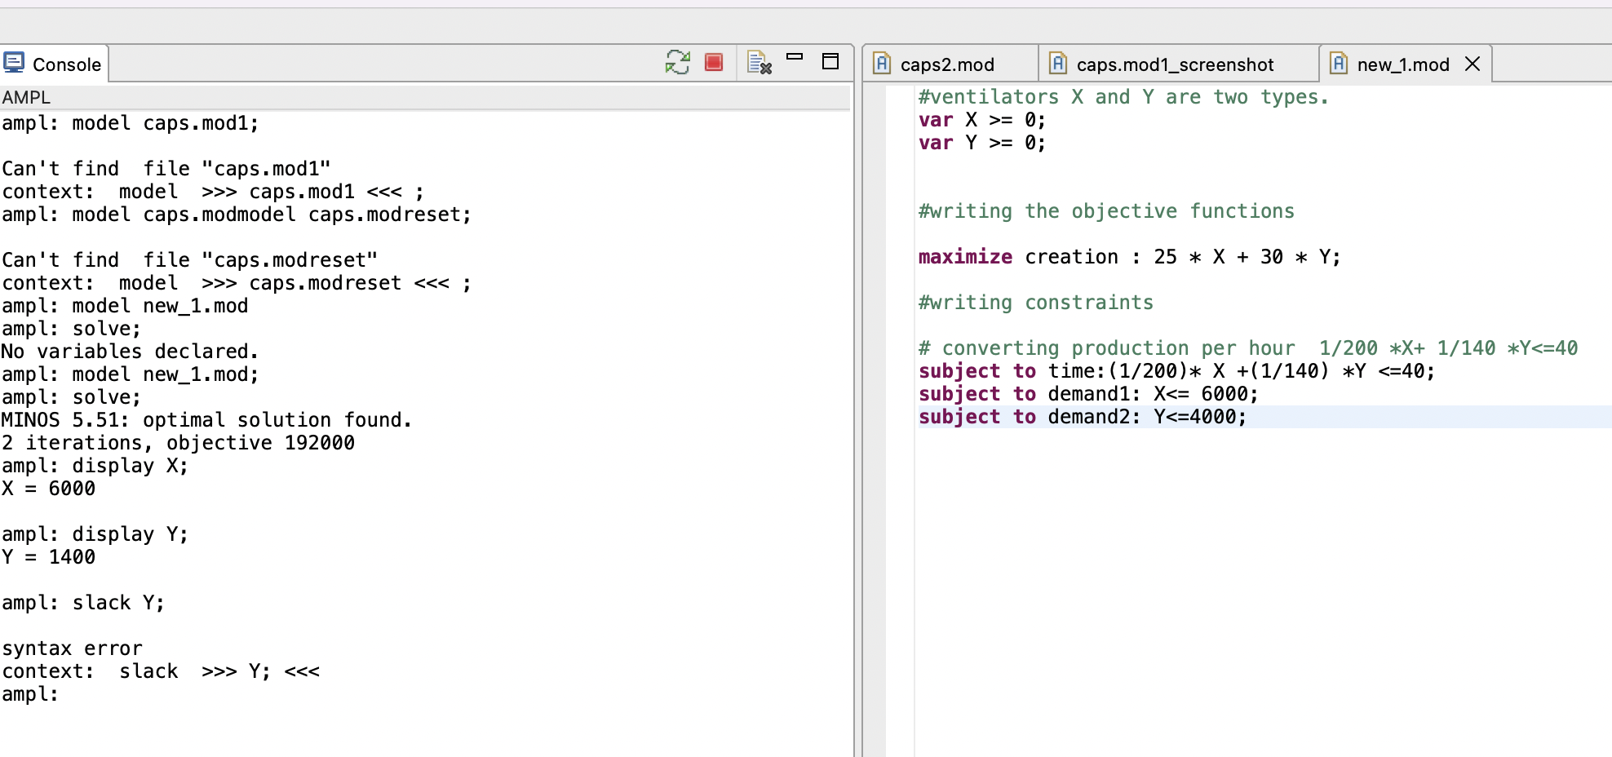
Solutions
Let's declare our decision variable constraints X for ventilator one and second ventilator for Y
Where
X>=0
Y>=0
Ventilator produced per hour=1/200 *X + 1/140 *Y <=40
Our objective function is to maximize the profit so
Profit per ventilator =25X+30Y
Limits shown in right hand side
Screenshot below in AMPL
Limits/constraints
Maximum Production X | 6000
Maximum Production Y | 4000
time (hours/week) | 40

Slide 4
Business questions and answers
Now just we can see that the optimal solution we got in objective function is maximum profit
Total objective profit amount is 192000
Our X decision variable value is 6000
Our Y decision variable value is 1400
Now if we check the slack value against the available constraints' values, we consume the actual creation of X ventilators equals to its maximum limit of creation .
Number of Y creation is 1400 which is less than its maximum creation limit 4000.
The time constraint is fully consumed as slack is 0 ,the time limit provided, and actual time taken is equal.
Question 1)It is feasible to produce any type of ventilator?
Answer: it is feasible to produce any type of ventilator provided our constraints are getting satisfied, also keeping nonnegative variables in mind as well.
feasible solution to this optimization problem.
Assume Type X=0 and type Y=4000
1/200*0+1/140*4000<=40
28<=40
Our equation still satisfies the limits so we can produce any type of ventilator as needed

Slide 5
Business questions and answers
Question 2
Which generates more profit?
Answer: If we investigate the profit per type equation definitely Type Y ventilators have more profit generation.
Question 3
Is it better to produce only one type of ventilator or both? If you decide to
produce both, in what proportion should each be produced?
Answer: We can produce both type of ventilators as even in current scenario we have created 1400 type Y ventilators ,we have still maximum limit of 4000.We are still under supply limit .As the profit per ventilators are concerned, we can create more Y type 2 ventilators as compared to Type X.
Example if I change the production per hour by
1/100*X +1/200*Y<=40, still under constraints so
We need to change the production per hour rate for both each ventilator .In present current scenario we have already reached the maximum of 6000 ventilators of Type X ventilator so can’t produce more now.
Type X has less profit per ventilator also.

Slide 6
Business questions and answers
Question 4
Finally, you will have to calculate the final profit of the production of ventilators. You should include in your analysis what would happen if your product presents any defects, how to compete in a market that is new for you and what you would do if you overproduce ventilators
or they undersell. If necessary, you should be willing to challenge the validity of the number of ventilators to produce given in the description above.
Answer: The final profit is 192000
If the product has any defects in anyone of the Type X or Y ventilators, we can choose one depending upon the feasible solution it gives.
If the product is new and have to compete in the market, we can make predictive analysis on how the previous organization ventilators prices and production on time affected the profit in the market.
The limits or production constraints of our company is too tight or more in compared to the peer organization production of ventilators.
The limits or demand slack will let us decide we need to overproduce or under produce ventilators. In this example the cost to produce cheapest individual ventilators if we assume 100 dollars that will surpass the profit amount violating constraints so its is not relevant in this given example.
Given our current scenario in the time constraints we have consumed 40 hours limit the actual value and maximum value are same.
The Type X ventilators are also reached the maximum production limit 6000 ventilators.
Now the Type Y ventilators is 1400 produced now ,but we have maximum limit of 4000.
So, we have available production capacity still there for 2600 ventilators, but Time constraints is not left to produce any extra Type Y ventilators so we cannot reuse this for any profits in this case.

